Slide 1
QR-Code detection and Authentication

Slide 2
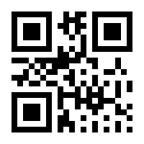
INTRODUCTION
A QR code (Quick Response code) is a type of matrix barcode.
They contain data for a locator, identifier, or tracker that points to a
website, text, number or application.
The required data is then extracted from patterns that are present in both horizontal and vertical components of the image.
QR code reader can identify a standard QR code based on the three large squares on the outside of the QR code. They then analyzes the QR code by breaking the whole thing down to a grid. It looks at the individual grid squares and assigns each one a value based on whether it is black or white.

Slide 3
FLOW CHART
Importing OpenCV, NumPy and pyzbar libraries
Authorizing and Un-authorizing codes by matching with text file.
Displaying the webcam window and adding some delay time.
Enabling webcam to scan. Opening the text file containing authorized data
Detecting and decoding QR-codes
Setting parameters for the bounding boxes around codes and adding texts.

Slide 4
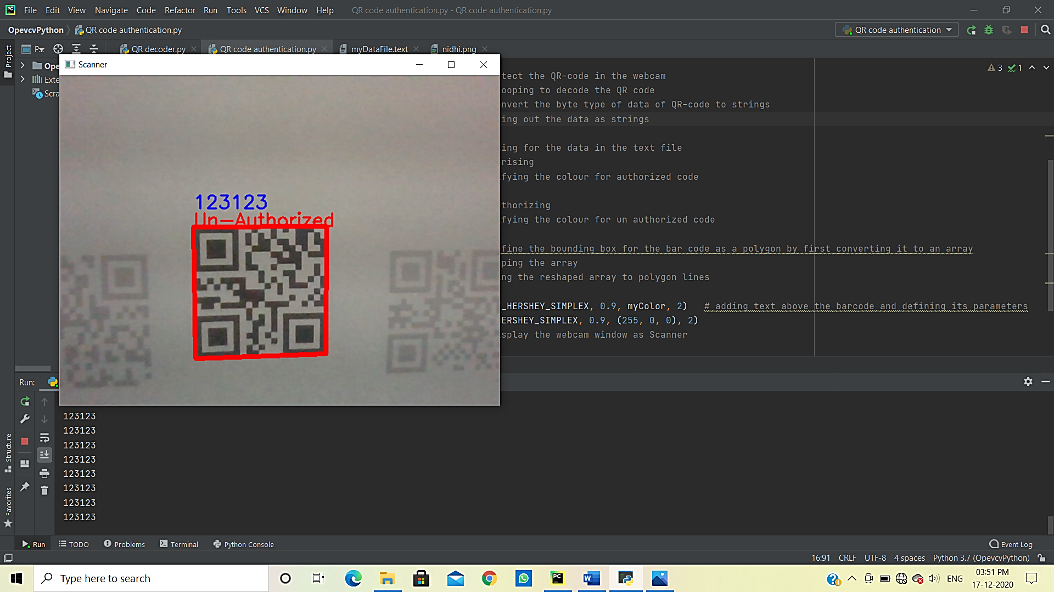
Execution snapshots

Slide 5
